Slide 1
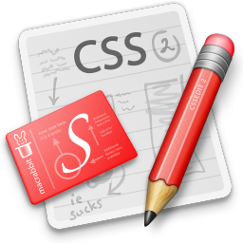
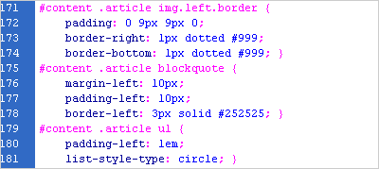
CSS Layout
Trần Anh Tuấn A
tuantran261083@gmail.com
Edit from Telerik Software Academy

Slide 2
Table of Contents
Positioning
Positioning inline elements
Floating
Left and right
Clearing
Opacity
Visibility
Display

Slide 3
Positioning

Slide 4
Positioning
position: defines the positioning of the element in the page content flow
The value is one of:
static (default)
relative – relative position according to where the element would appear with static position
absolute – position according to the innermost positioned parent element
fixed – same as absolute, but ignores page scrolling

Slide 5
Positioning (2)
Margin VS relative positioning
Fixed and absolutely positioned elements do not influence the page normal flow and usually stay on top of other elements
Their position and size is ignored when calculating the size of parent element or position of surrounding elements
Overlaid according to their z-index
Inline fixed or absolutely positioned elements can apply height like block-level elements

Slide 6
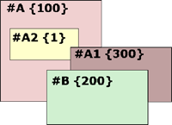
Positioning (3)
top, left, bottom, right: specifies offset of absolute/fixed/relative positioned element as numerical values
z-index : specifies the stack level of positioned elements
Understanding stacking context
Each positioned element creates a stacking context.
Elements in different stacking contexts are overlapped according to the stacking order of their containers. For example, there is no way for #A1 and #A2 (children of #A) to be placed over #B without increasing the z-index of #A.

Slide 7
Inline element positioning
vertical-align: sets the vertical-alignment of an inline element, according to the line height
Values: baseline, sub, super, top, text-top, middle, bottom, text-bottom or numeric
Also used for content of table cells (which apply middle alignment by default)

Slide 8
Floating

Slide 9
Float
float: the element “floats” to one side
left: places the element on the left and following content on the right
right: places the element on the right and following content on the left
floated elements should come before the content that will wrap around them in the code
margins of floated elements do not collapse
floated inline elements can apply height

Slide 10
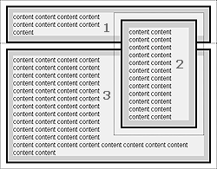
Float (2)
How floated elements are positioned

Slide 11
Clear
clear
Sets the sides of the element where other floating elements are NOT allowed
Used to "drop" elements below floated ones or expand a container, which contains only floated children
Possible values: left, right, both
Clearing floats
additional element (<div>) with a clear style

Slide 12
Clear (2)
Clearing floats (continued)
:after { content: ""; display: block; clear: both; height: 0; }
Triggering hasLayout in IE expands a container of floated elements
display: inline-block;
zoom: 1;

Slide 13
Opacity

Slide 14
Opacity
opacity: specifies the opacity of the element
Floating point number from 0 to 1
For old Mozilla browsers use –moz-opacity
For IE use filter:alpha(opacity=value) where value is from 0 to 100; also, "binary and script behaviors" must be enabled and hasLayout must be triggered, e.g. with zoom:1

Slide 15
Visibility

Slide 16
Visibility
visibility
Determines whether the element is visible
hidden: element is not rendered, but still occupies place on the page (similar to opacity:0)
visible: element is rendered normally

Slide 17



Display

Slide 18
Display
display: controls the display of the element and the way it is rendered and if breaks should be placed before and after the element
inline: no breaks are placed before and after (<span> is an inline element)
block: breaks are placed before AND after the element (<div> is a block element)

Slide 19
Display (2)
display: controls the display of the element and the way it is rendered and if breaks should be placed before and after the element
none: element is hidden and its dimensions are not used to calculate the surrounding elements rendering (differs from visibility: hidden!)
There are some more possible values, but not all browsers support them
Specific displays like table-cell and table-row

Slide 20
CSS Layout
http://academy.telerik.com

Slide 21
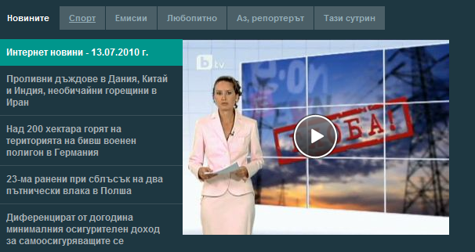
Homework
Create the following Web page using HTML and external CSS. Using tables, inline styles and deprecated tags is not allowed.

Slide 22
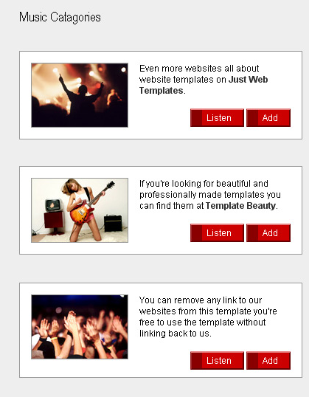
Homework (2)
Create the following Web page using external CSS styles. Buttons should consist of PNG images with text over them.

Slide 23
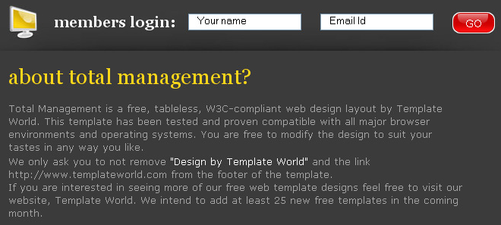
Homework (3)
Create the following Web page using HTML with external CSS file. Note that the images should be PNG with transparent background.

Slide 24
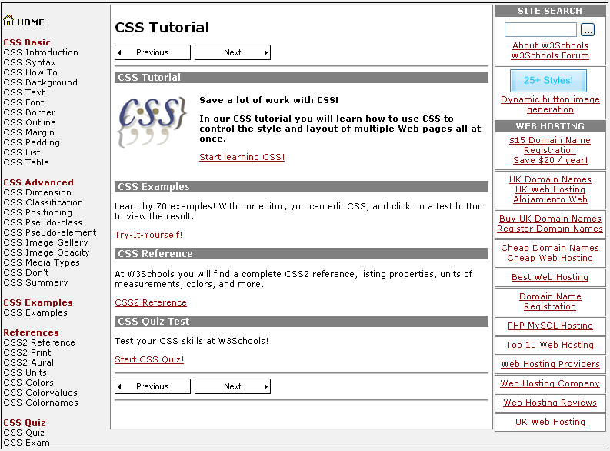
Homework (4)
Given the picture below create the Web site
Use CSS and HTML 5

Slide 25
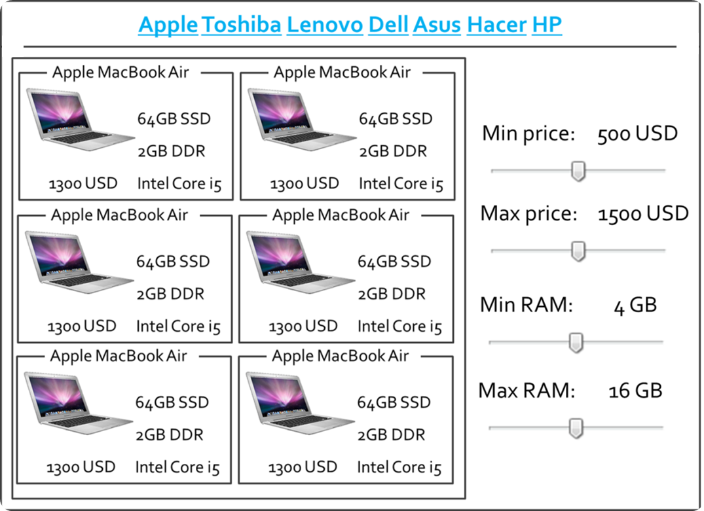
Homework (5)
Create the following HTML 5 Page
Do it without tables

Slide 26
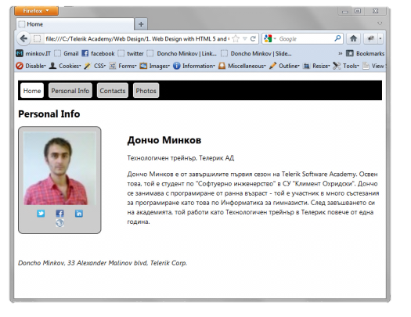
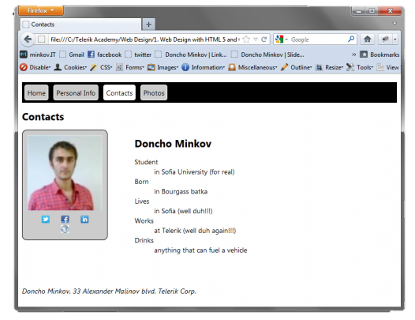
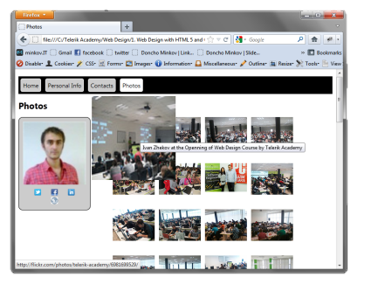
Homework (6)
Create the following mini-web site
You can use different pictures and text

